Slide 1
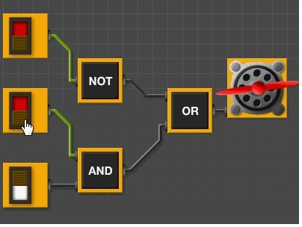
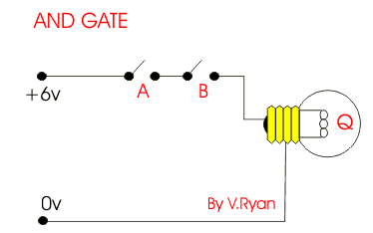
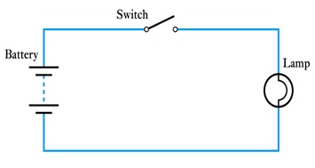
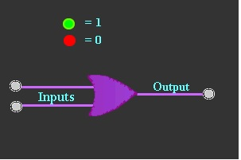
Electronics
Digital Gate
FY – DESH – VIT

Slide 2
Contents
Concept of Binary Logic
- Boolean Algebra
- De-Morgan’s Theorem
- Simplification of Boolean expressions
- Concept of K-Maps
Logic Gates and Truth Table
- NAND and NOR as Universal Gates
Half Adder and Full Adder
Flip-Flops
- JK and D Flip-Flops

Slide 3
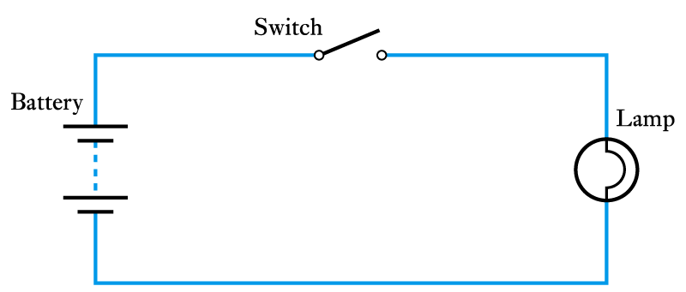
Concept of Binary Logic
A binary quantity is one that can take only 2 states.
S | L
OPEN | OFF
CLOSED | ON
S | L
0 | 0
1 | 1

Slide 4
Binary Logic
In Binary logic, the addition is,
0 + 0= 0
0 + 1= 1
1 + 0= 1
1 + 1= 1
The Multiplication of two bits is,
0.0=0
0.1=0
1.0=0
1.1=1

Slide 5
Logic Gates
The building blocks used to create digital circuits are logic gates.
There are three elementary logic gates and a range of other simple gates.
Each gate has its own logic symbol which allows complex functions to be represented by a logic diagram.
The function of each gate can be represented by a truth table or using Boolean notation.

Slide 6
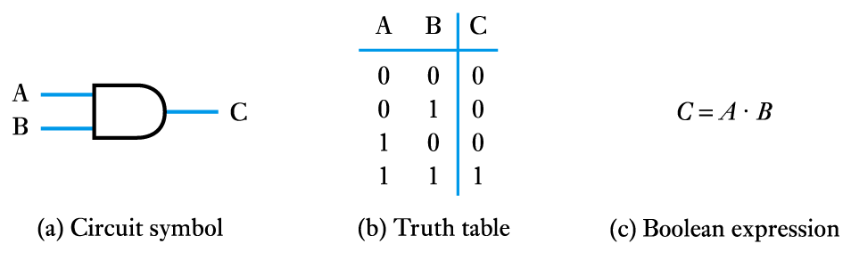
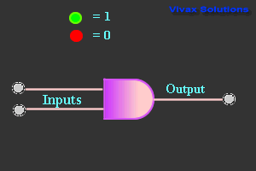
AND Gate

Slide 7
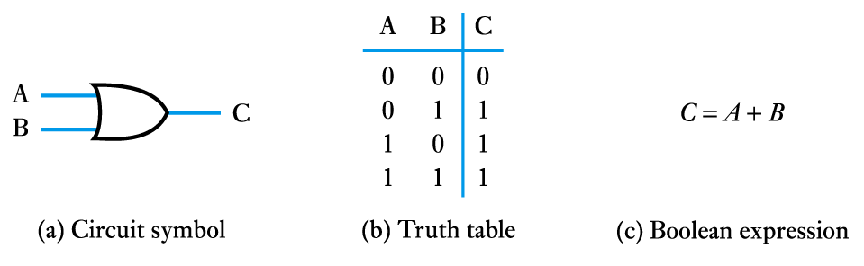
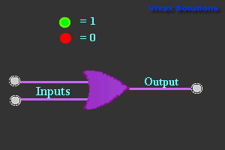
OR Gate

Slide 8
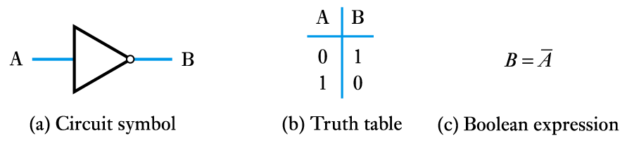
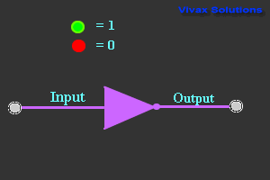
NOT Gate (Inverter)

Slide 9
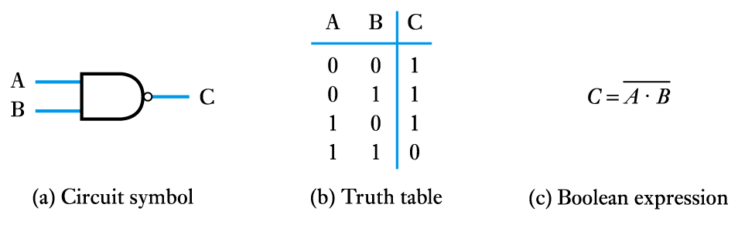
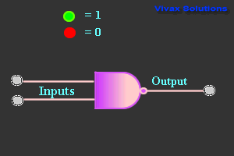
NAND Gate

Slide 10
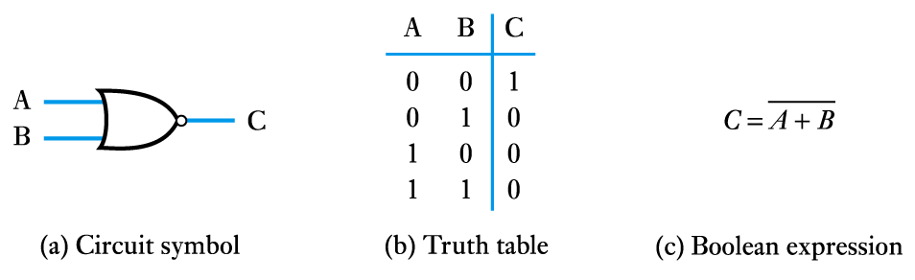
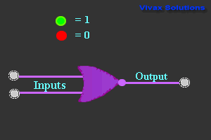
NOR Gate

Slide 11
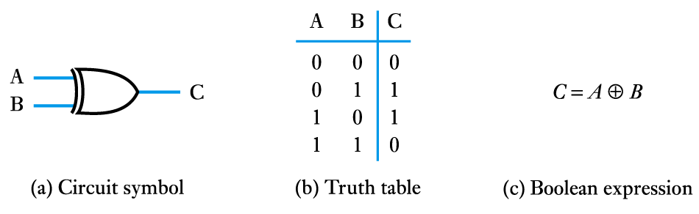
Ex-OR Gate

Slide 12
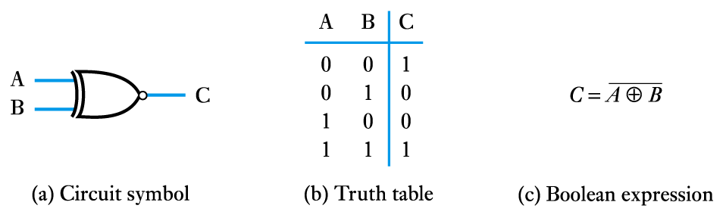
Ex-NOR Gate

Slide 13
Universal Gates
A universal gate is a gate which can implement any Boolean function without need to use any other gate type.
The NAND and NOR gates are universal gates.
In practice, this is advantageous since NAND and NOR gates are economical and easier to fabricate and are the basic gates used in all IC digital logic families.

Slide 14
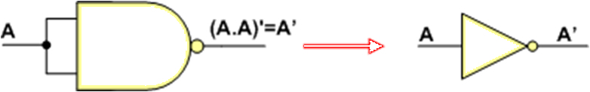
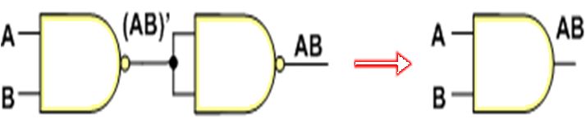
NAND as Universal Gate
Implementing Inverter with only NAND gates:
Implementing AND gate with only NAND gates:

Slide 15
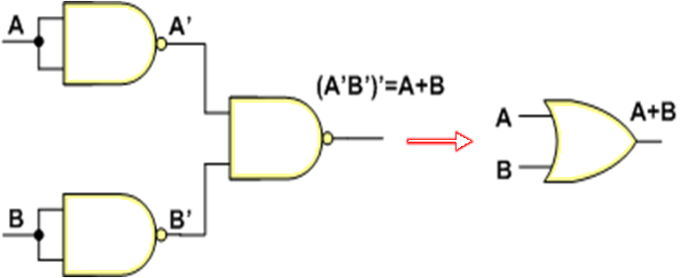
NAND as Universal Gate
Implementing OR gate with only NAND gates

Slide 16
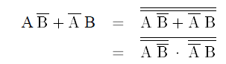
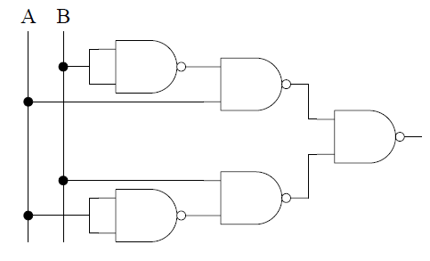
NAND as Universal Gate
Implementing Ex-OR gate with only NAND gates

Slide 17
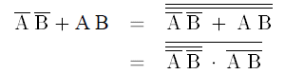
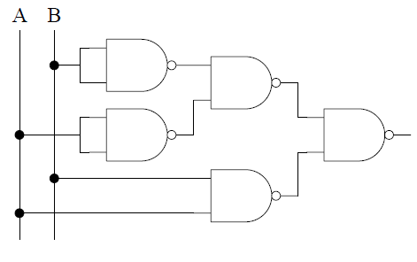
NAND as Universal Gate
Implementing Ex-NOR gate with only NAND gates

Slide 18
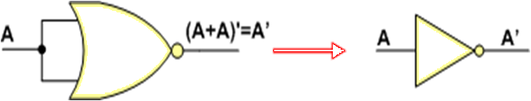
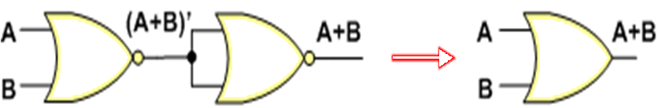
NOR as Universal Gate
Implementing OR gate with only NOR gates:
Implementing OR gate with only NOR gates:

Slide 19
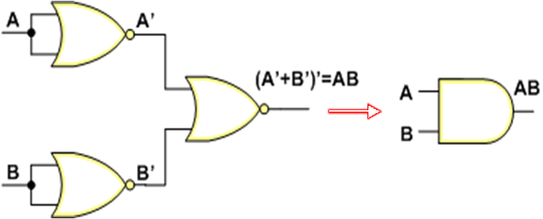
NOR as Universal Gate
Implementing AND gate with only NOR gates

Slide 20
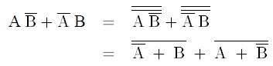
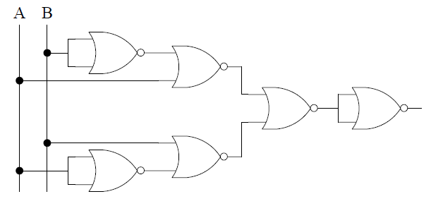
NOR as Universal Gate
Implementing Ex-OR gate with only NOR gates

Slide 21
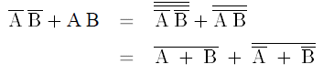
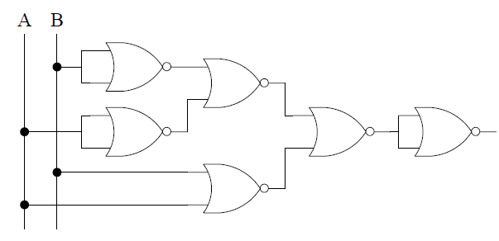
NOR as Universal Gate
Implementing Ex-NOR gate with only NOR gates

Slide 22
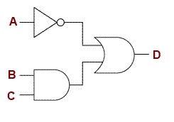
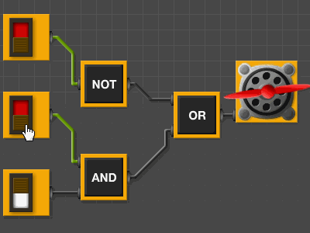
Example#1
Since there are three inputs, the possibilities are, 2³ = 8.

Slide 23
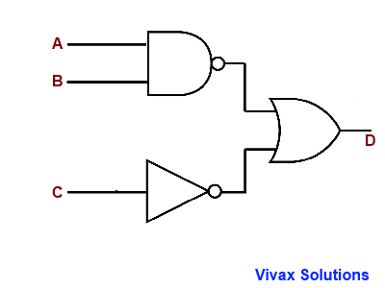
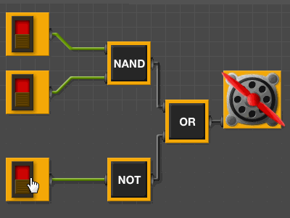
Example#2
Since there are three inputs, the possibilities are, 2³ = 8.

Slide 24
IDENTIFY GATE LOGIC ?

Slide 25
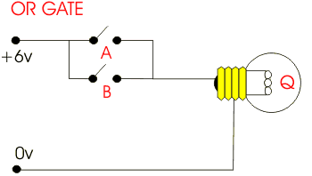
IDENTIFY GATE LOGIC ?

Slide 26
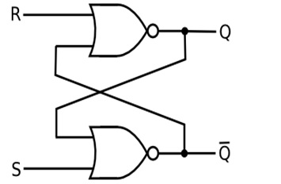
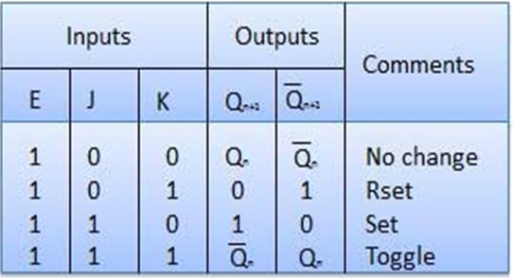
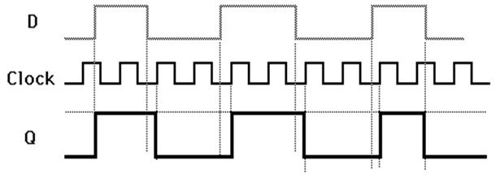
Electronics 7.2
FLIP-FLOPS
FY – DESH – VIT

Slide 27
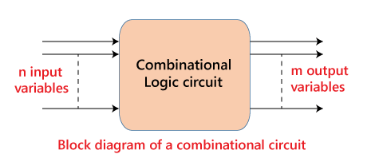
Combinational Logic circuits
When logic gates are connected together to produce a specified output for certain specified combinations of input variables, with no storage involved , the resulting circuit is called as combinational logic.
The output of the combinational circuit is determined from the present combination of inputs, regardless of the previous input.
The input variables, logic gates, and output variables are the basic components of the combinational logic circuit.

Slide 28
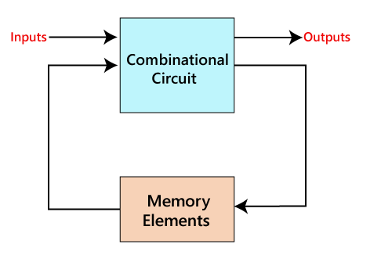
Sequential circuit
Memory element are connected to combinational circuit as a feedback path.
The outputs of the sequential circuits depend on both the combination of present inputs and previous outputs.

Slide 29
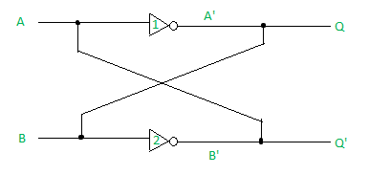
Flip Flops
Flip flops are the basic building blocks of any sequential circuit.
One flip flop can store one bit of information.
A flip flop is a bistable electronic circuit having two stable states i.e. its output is either low or high.
when A=0,
(i) In inverter1, Q = A'= B= 1
(ii)In inverter2, Q' = B' = A = 0
(B) when A=1,
(i) In inverter1, Q = A'= B= 0
(ii)In inverter2, Q' = B' = A = 1
One bit memory cell

Slide 30
Latch
The most elementary form of Flip flops is a Latch.
Latch has two stable output states Q and Q.
The outputs Q and Q are always complementary.
The circuit has two stable states; in one of the stable Q=high or 1 which is referred to as a 1 state (or set state) whereas in other state Q=0 which is referred to as the 0 state (or reset state).
If the circuit is in 1 state, it continues to remain in this state and similarly if it is in 0 state, it continues to remain in this state. This property of the circuit is referred to as ‘memory’, i.e. it can store 1-bit of digital information.

Slide 31
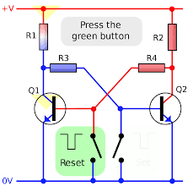
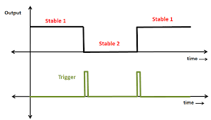
FLIP –FLOP using Transistor(Bistable multivibrator)
Q
¯
Q
Vishwakarma Institute of Technology
FY - Department of Engineering, Sciences and Humanities
Q¯ = 1
Q1=ON , Q2=OFF Q= 0,

Slide 32
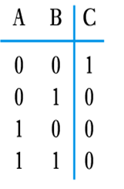
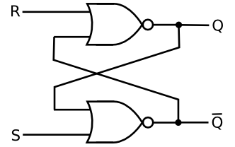
S-R Latch
Truth table - NOR
Implementation of S-R latch using NOR gates .
0
1
1
0
0
1
0
0
1
0
0
Vishwakarma Institute of Technology
0
FY - Department of Engineering, Sciences and Humanities
Truth table of S-R Latch
1
1
S | R | Q | ¯
0 | 0 | Memory ( As previous)
0 | 1 | 0 | 1
1 | 0 | 1 | 0
1 | 1 | Invalid/Unstable
Q = 0
Case I : S =0 , R=1, Q = 0 & ¯
Q = 1
Q = 0
Case II : S =1 , R=0, Q = 1 & ¯
Case III: S = 1 , R =1 , Q = 0 & ¯
Q = 1

Slide 33
SR Latch (NAND version)
0
S’
S’ R’ Q Q’
Q
1
0 0
0 1
1 0
1 1
1 1 Disallowed
1 0 Set
0 1 Reset
Q’
1
0
R’
1 0 Hold
Vishwakarma Institute of Technology
0 1 Hold
FY - Department of Engineering, Sciences and Humanities
X Y NAND
Memory
0 0 1
0 1 1
1 0 1
1 1 0

Slide 34
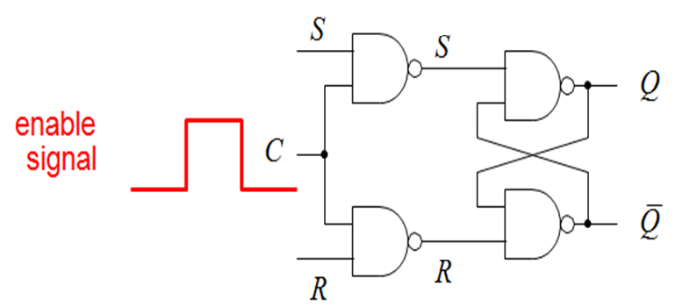
SR Latch with Enable (CLK SR Flip-Flop)
*
*
Vishwakarma Institute of Technology
FY - Department of Engineering, Sciences and Humanities
CLK | S | R | Q | ¯
0 | × | × | Memory
1 | 0 | 0 | Memory
1 | 0 | 1 | 0 | 1
1 | 1 | 0 | 1 | 0
1 | 1 | 1 | Not used
Q
Truth Table of SR Flip-flop

Slide 35
SR Latch with Enable (SR Flip-Flop)
Truth table of SR Latch with NAND gate
CLK | S | R | Q | ¯
0 | × | × | Memory
1 | 0 | 0 | Memory
1 | 0 | 1 | 0 | 1
1 | 1 | 0 | 1 | 0
1 | 1 | 1 | Not used
Q
S* | R* | Q | ¯
0 | 0 | Not Used
0 | 1 | 1 | 0
1 | 0 | 0 | 1
1 | 1 | Memory
Q
Find S*
S* = ( ) = +
R* = ( ) = +
Vishwakarma Institute of Technology
FY - Department of Engineering, Sciences and Humanities
Case 1) When CLK = O , value of S* = 1 , R* =1
Case 2) When CLK = 1 , value of S* = S¯ , R* =
So when S=0 , R=0 then S* = 1 and R* =1 , so output is memory.
Case 3) When CLK = 1 , So when S=0 , R=1, then value of S* = 1, R*=0 ,
Output is 0 and 1 .
Case 4) When CLK =1 , S=1, R=0 , then S* = 0 , R*=1, output is 1 and 0.
Case 5) When CLK = 1 , S*=R*=0 , so when S=R=1 , output is not valid.

Slide 36
D-Flip Flop
SR flip-flop requires two inputs, one to “SET” the output and one to “RESET” the output. By connecting an inverter (NOT gate) to the SR flip-flop we can “SET” and “RESET” the flip-flop using just one input
A single data bit D is required to drive the flip-flop.
The D flip-flop is either used as a delay device or as a latch to store 1-bit binary information.

Slide 37
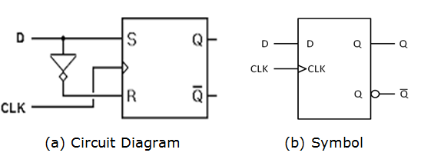
D Flip-Flop
The circuit diagram and symbol of D flip-flop (positive level triggered) are as shown in figure
Vishwakarma Institute of Technology
FY - Department of Engineering, Sciences and Humanities
Truth Table of D flip-flop
CLK | D | Qn
0 | × | Previous output
1 | 0 | 0
1 | 1 | 1

Slide 38
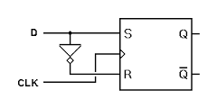
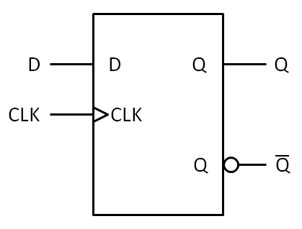
D-Flip Flop
The circuit diagram and symbol of D flip-flop (NEGATIVE level triggered) are as shown in figure
(a) Circuit Diagram (b) Symbol

Slide 39

D Flip-Flop
Vishwakarma Institute of Technology
FY - Department of Engineering, Sciences and Humanities

Slide 40
J-K Flip Flop
The J-K flip-flop is very versatile and is most widely used.
The functioning of J-K flip-flop is identical to that of R-S flip-flop in RESET, SET and no change conditions of operation.
The J-K flip-flop has no invalid state as that R-S flip-flop.

Slide 41



J-K Flip Flop
The circuit diagram and symbol are as shown in figure
(a) Circuit Diagram (b) Symbol

Slide 42


JK Flip-Flop
1
1
0
1
0
1
0
1
1
1
1
1
1
0
1
1
0
Vishwakarma Institute of Technology
FY - Department of Engineering, Sciences and Humanities
Case 1) CLK = 1 , J=K = O , O/P is memory state.
Case 2) CLK =1 , J=1, K=0 , Q=1, ¯
Q = 0
Case 3) CLK =1, J = 0 , K =1, Q=0, ¯
Case 4) CLK =1 , J =1 , K =1
Assume , Q=0 , ¯
Q =1
Q =1 Hence Q=1 , ¯
Q = 0

Slide 43

J-K Flip Flop
Logic Diagram of clocked J-K Flip-Flop,

Slide 44

J-K Flip Flop
The truth table of J-K flip-flop is,

Slide 45


T (Toggle) Flip -Flop
CLK | T | Qn+1
0 | × | Qn(memory)
1 | 0 | Qn(memory)
1 | 1 | ¯ ( Toggle)
Qn
Vishwakarma Institute of Technology
FY - Department of Engineering, Sciences and Humanities
If J=K the resulting flip-flop is known as T type of flip-flop

Slide 46
WHERE WE USE FLIP FLOPS?
1) Registers: As the flip flops have two stable states, we use them in memory elements like registers, for data storage. Generally we use registers in electronic devices like computers.
2) Counters: The groups of interconnected flip flops are uses as counters, to count the increment or decrement of an event occurrence.
3) Frequency division: Flip flops are used as frequency division circuits, which divide the input frequency to exactly to its half. Frequency division circuits are used to regularize the frequency of electronic circuits.
4) Data transfer: We use shift registers (A special-type of registers) to transfer the data from one flip flop to another, which are connected in a specific order.
Vishwakarma Institute of Technology
FY - Department of Engineering, Sciences and Humanities

Slide 47



Triggering method of flip-flop
Trigger : The state of a latch or flip-flop is switched by a change of the control input or clock.
Two Types of Triggering : 1) Level
2) Edge

Slide 48



Electronics 7.3
SHIFT REG & COUNTER
FY – DESH – VIT

Slide 49

Shift Register
The Shift Register is another type of sequential logic circuit that can be used for the storage or the transfer of binary data.
Notes:
https://www.electronics-tutorials.ws/sequential/seq_5.html

Slide 50

Shift Registers - Data Movement
The bits in a shift register can move in any of the following manners.
Vishwakarma Institute of Technology
FY - Department of Engineering, Sciences and Humanities

Slide 51
Shift Register four different modes
Serial-in to Parallel-out (SIPO) - the register is loaded with serial data, one bit at a time, with the stored data being available at the output in parallel form.
Serial-in to Serial-out (SISO) - the data is shifted serially “IN” and “OUT” of the register, one bit at a time in either a left or right direction under clock control.
Parallel-in to Serial-out (PISO) - the parallel data is loaded into the register simultaneously and is shifted out of the register serially one bit at a time under clock control.
Parallel-in to Parallel-out (PIPO) - the parallel data is loaded simultaneously into the register, and transferred together to their respective outputs by the same clock pulse.
Notes:
https://www.electronics-tutorials.ws/sequential/seq_5.html

Slide 52

4-bit Shift Register Animation -
Notes:
In the animation, we start by resetting the flip-flops. Since they all connect to a single control line, a single high pulse is all that is required to reset them simultaneously.
Let us assume that we need to load the 4-bit register with binary 0 0 0 1. Then we should feed binary 1 on the first leading edge of the clock pulse, binary 0 on the second leading edge, binary 0 on the third leading edge, and finally binary 0 on the fourth leading edge.
The animation begins by introducing logic 1 at the serial input, however, at this point, the clock pulse is on the falling edge and nothing happens until the leading edge of the next clock pulse. The leading edge is in red and the falling edge (or trailing edge) in blue.
Keep your eyes on the clock pulses and the logic 1 at the output. You should see that on the leading edge of every clock pulse the logic 1 state moves through successive stages. However, on the falling edge, the state remains locked and nothing happens.

Slide 53

Serial-in to Parallel-out (SIPO) Shift Register
4-bit Serial-in to Parallel-out Shift Register
Notes:
https://www.electronics-tutorials.ws/sequential/seq_5.html

Slide 54


Basic Data Movement Through A Shift Register

Slide 55

4-bit Serial-in to Serial-out Shift Register

Slide 56

4-bit Parallel-in to Serial-out Shift Register

Slide 57

4-bit Parallel-in to Parallel-out Shift Register

Slide 58
Counter
A special type of sequential circuit used to count the pulse is known as a counter.
It is a group of flip-flops with a clock signal applied.
Counters are used in digital electronics for counting purpose, they can count specific event happening in the circuit.
Counters are of two types :
Asynchronous or ripple counters.
Synchronous counters.
Vishwakarma Institute of Technology
FY - Department of Engineering, Sciences and Humanities

Slide 59
Types of Counter
Asynchronous Counters
Only the first flip-flop is clocked by an external clock. All subsequent flip-flops are clocked by the output of the preceding flip-flop.
Asynchronous counters are slower than synchronous counters because of the delay in the transmission of the pulses from flip-flop to flip-flop.
Asynchronous counters are also called ripple-counters because of the way the clock pulse ripples it way through the flip-flops.
Synchronous Counters
All flip-flops are clocked simultaneously by an external clock.
Synchronous counters are faster than asynchronous counters because of the simultaneous clocking.
Synchronous counters are an example of state machine design because they have a set of states and a set of transition rules for moving between those states after each clocked event
Vishwakarma Institute of Technology
FY - Department of Engineering, Sciences and Humanities

Slide 60


2 bit Asynchronous or ripple counters
Total 4 states , i.e 2^{n} , 2² = 4 where n = Total number of flip-flop
Maximum count = 2^{n}-1 = 3
Vishwakarma Institute of Technology
0
1
2
3
4
FY - Department of Engineering, Sciences and Humanities
CLK | Q₁ | Q₀ | _{Decimal Equa}
0 | 0 | 0 | 0
1 | 0 | 1 | 1
2 | 1 | 0 | 2
3 | 1 | 1 | 3
1
1
0
0
0
1
1
0

Slide 61

Counter
Johnson Ring Counter
The Johnson Ring Counter consists of a number of counters connected together with the output fed back to the input.
Notes:
https://www.electronics-tutorials.ws/sequential/seq_6.html

Slide 62

4-bit Ring Counter
Notes:
https://www.electronics-tutorials.ws/sequential/seq_6.html

Slide 63

4-bit Ring Counter
In the above table, the highlighted 1's are pre-set 1.
The Pre-set 1 is generated when
ORI input set to low, and that time the Clk doesn't care.
When the ORI input set to high, and the low clock pulse signal is passed as the negative clock edge triggered.
A ring forms when the pre-set 1 is shifted to the next flip-flop at each clock pulse.
Notes:
https://www.electronics-tutorials.ws/sequential/seq_6.html

Slide 64


Rotational Movement of a Ring Counter

Slide 65

4-bit Johnson Ring Counter

Slide 66
4-bit Johnson Ring Counter

Slide 67

Truth Table for a 4-bit Johnson Ring Counter
Notes:
https://www.electronics-tutorials.ws/sequential/seq_6.html

Slide 68


Electronics
Shift Register, Counter
Thanks !
FY – DESH – VIT

